Slide 1
Analyzing Foodborne Disease Outbreaks Over Time
A look into illnesses and more from 1998 to 2015

Slide 2
Group 12 Introductions
Trina Shores
Steven Macapagal
Journey Martinez
Yuan Yao
Heather Nagy
Kenneth Porter

Slide 3
Trina Shores
Major - Graduate Certificate Statistics & Analytics
Role - group leader
Responsibility - provide guidance on appropriate research themes and add context to analysis

Slide 4
Steven Macapagal
Major - Statistics
Role - editor, facilitator, analysis
Responsibility - provide graphical analysis, edit slide deck

Slide 5
Journey Martinez
Major - Statistics
Role - analysis and computation
Responsibility - provide statistical analysis, tabulation, and contribute to report

Slide 6
Yuan Yao
Major - Biology
Role - statistical analysis; prior literature
Responsibility - review previous research

Slide 7
Heather Nagy
Major - Statistics
Role - Analysis, individual contributor
Responsibility - Contribute data set insights and preliminary analysis to report

Slide 8
Kenneth Porter
Major -Statistics
Role -editor
Responsibility -Combining team’s work into consolidated reports

Slide 9
Data on foodborne illnesses

Slide 10
The data set
Primary measurements are illnesses, hospitalizations, and fatalities for each outbreak
Other variables include date, US state, location, food or ingredient, type of bacteria or virus
Data are reported monthly from January 1998 to December 2015
Over 19,000 different outbreaks recorded
From a Kaggle data set provided by the Centers for Disease Control and Prevention (https://www.kaggle.com/datasets/cdc/foodborne-diseases)

Slide 11
Our goals
How is the rate of foodborne illness changing over time?
Directional trends
Changes in variability
Cyclical trends
Is there a seasonal component to this trend?
Are there relationships to hospitalizations, fatalities, or external factors?

Slide 12
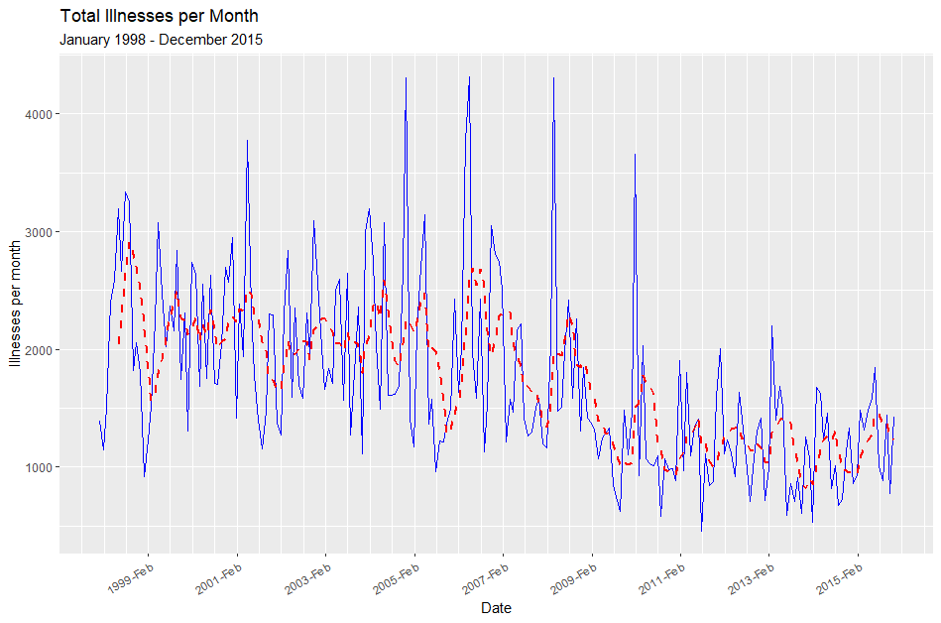
Total illnesses per month appear to decline over time and are less variable over time.
Solid blue line represents the original time series
Dotted red line represents a filtered time series over a 6-month period

Slide 13
Total illnesses per month appear to decline over time and are less variable over time.
Variability is much greater from 1998 to 2008 and decreases from 2009 to 2015. Illnesses also seem to be cyclical.

Slide 14
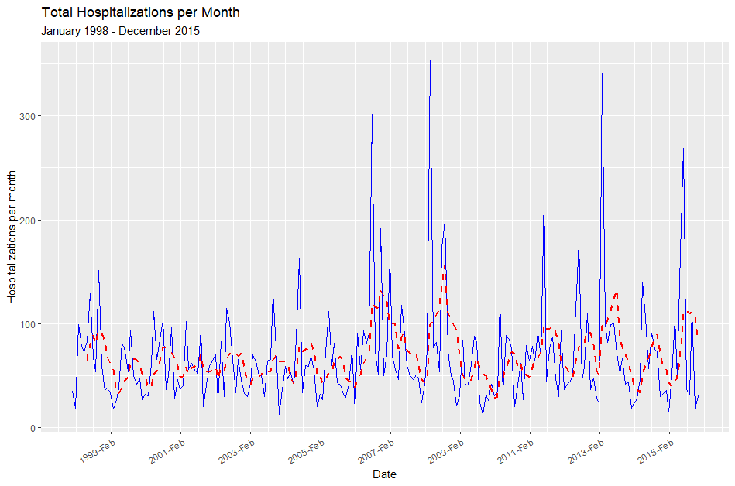
Total hospitalizations per month seem to remain constant, but their variability is increasing over time.
The variability starts increasing from 2006 to 2015. Hospitalizations also show some cyclic nature.

Slide 15
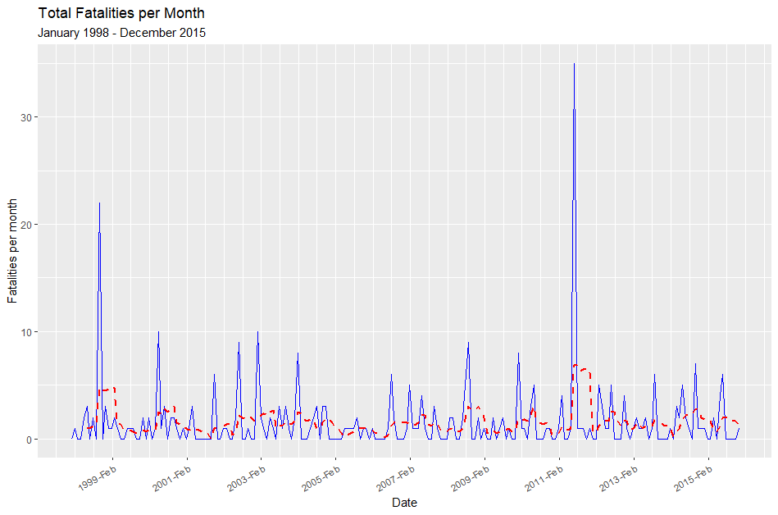
Total fatalities per month remain constant over time with occasional peaks in early 1999 and 2011.
The filtered time series does not seem to show any clear trend over time.

Slide 16
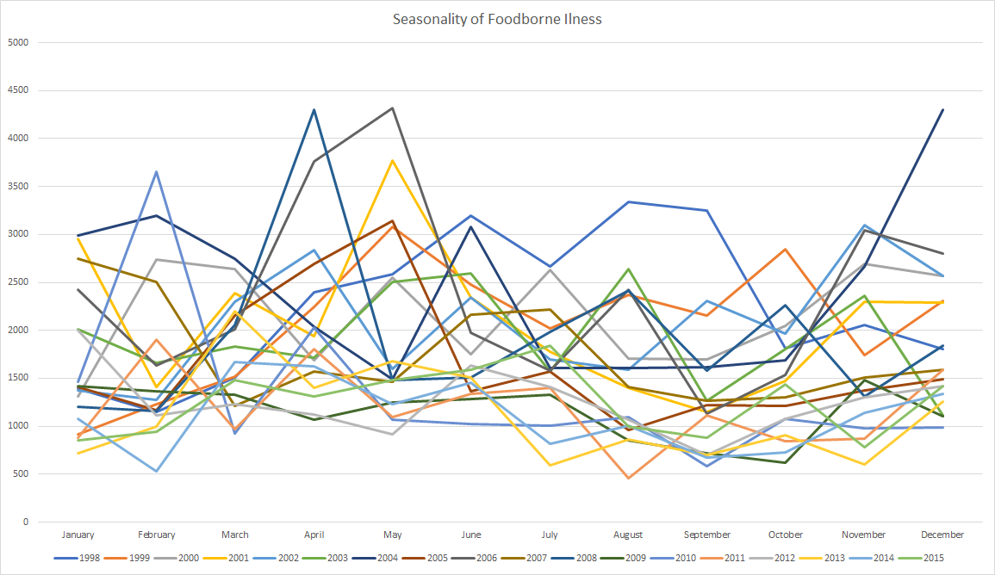
Seasonality of Total Illness per year
There appears to be no visually clear seasonality pattern but the highest counts appear to be between February and May while the lowest are between July and November

Slide 17
Future areas of research
Looking at autocorrelation over illnesses month-to-month
Calculating cross-correlations between time series to see if there is a relationship between illnesses and hospitalizations, illnesses and fatalities, etc.
Build an appropriate model of illnesses over time

Slide 18
Questions, comments, suggestions?

Slide 19
Thank you for your
engagement and feedback!

